Slide 1



MetaConstruct
PRESENTED BY
Subhan Amjad || Muhammad Musa
Abdul Moiz || Muhammad Huzaifa Bilal
Muhammad Ali Nasir || Hafiz Shoaib

Slide 2
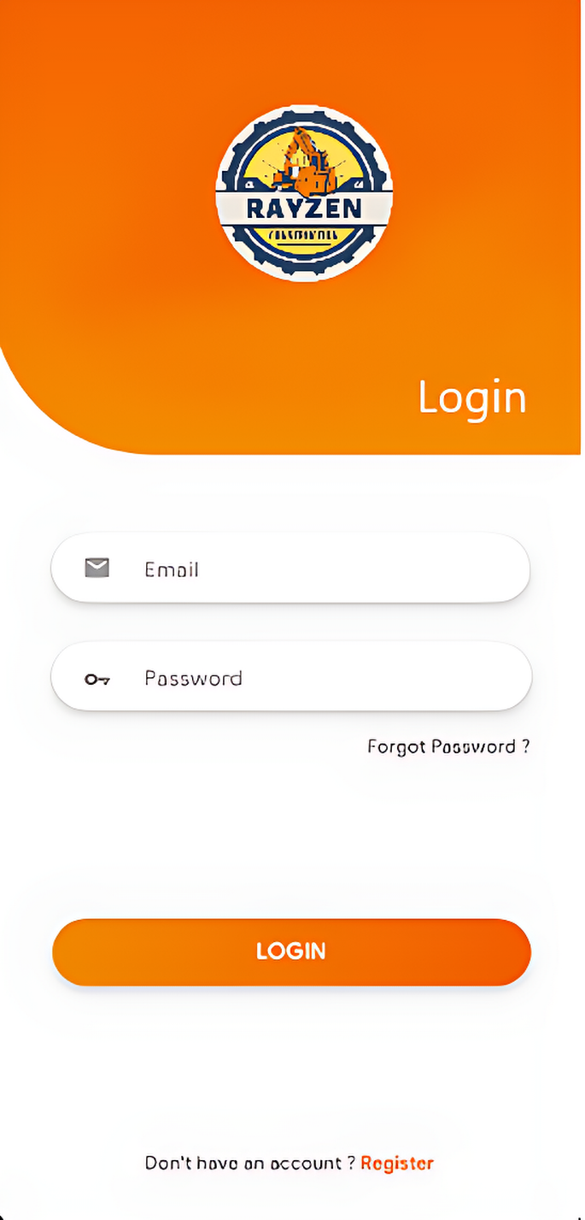
USE-CASES:
Customer Use-Case
Agency Use-Case
Admin Use-Case

Slide 3
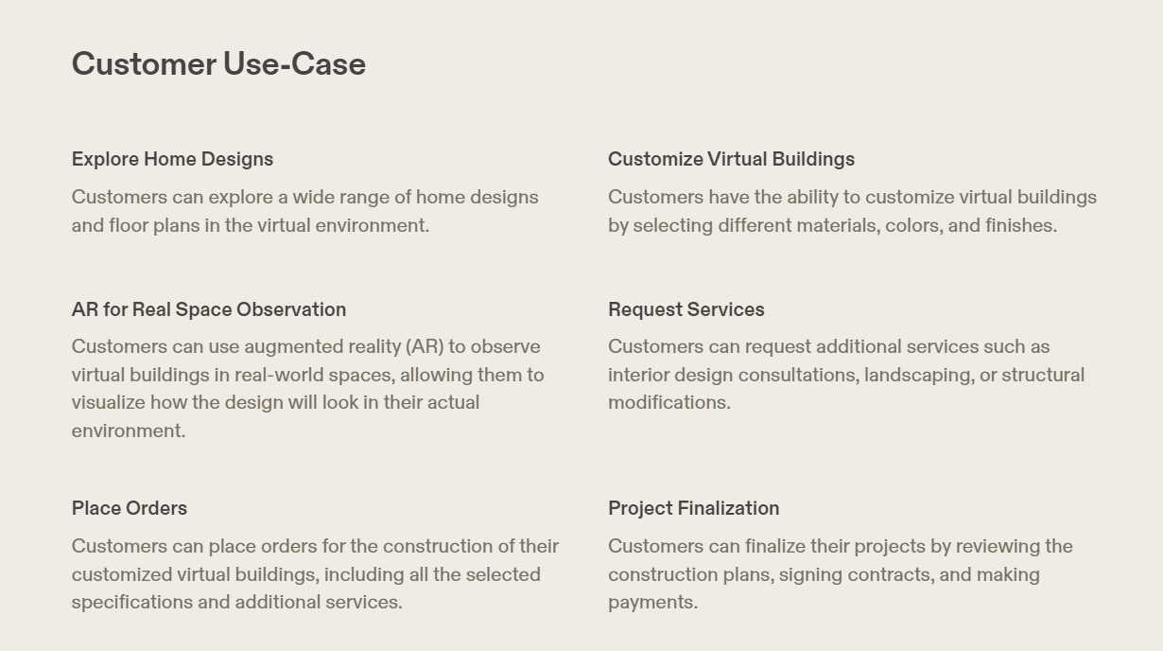

Slide 4
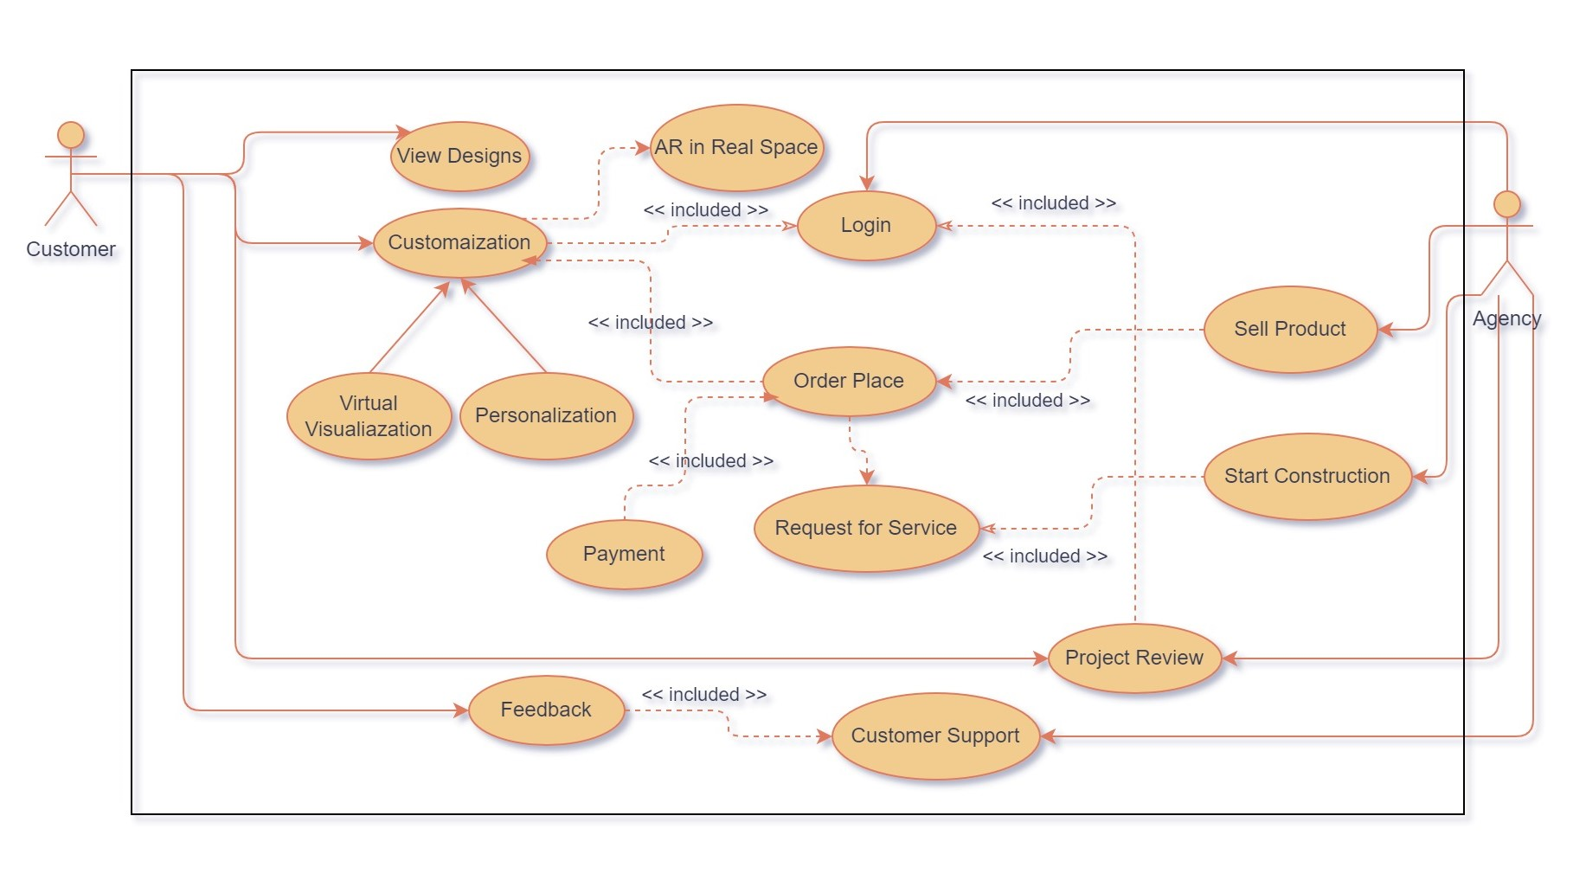
CUSTOMER USE-CASE

Slide 5
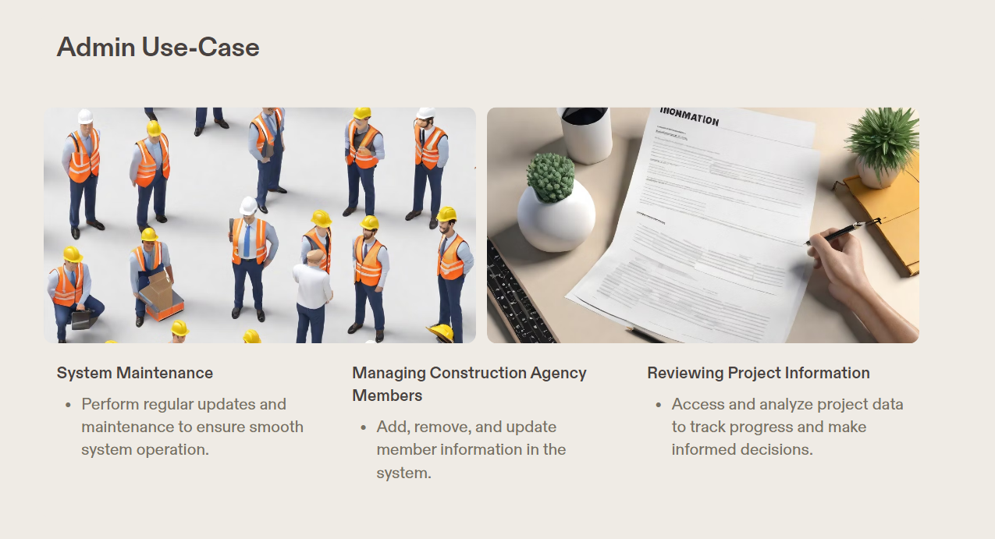

Slide 6
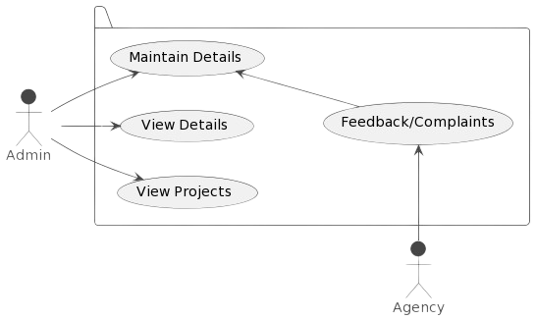
ADMIN USE-CASE

Slide 7
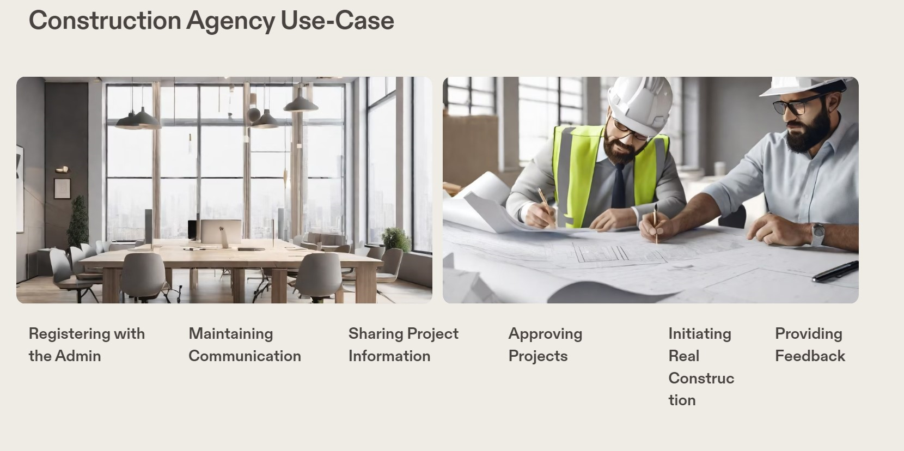

Slide 8
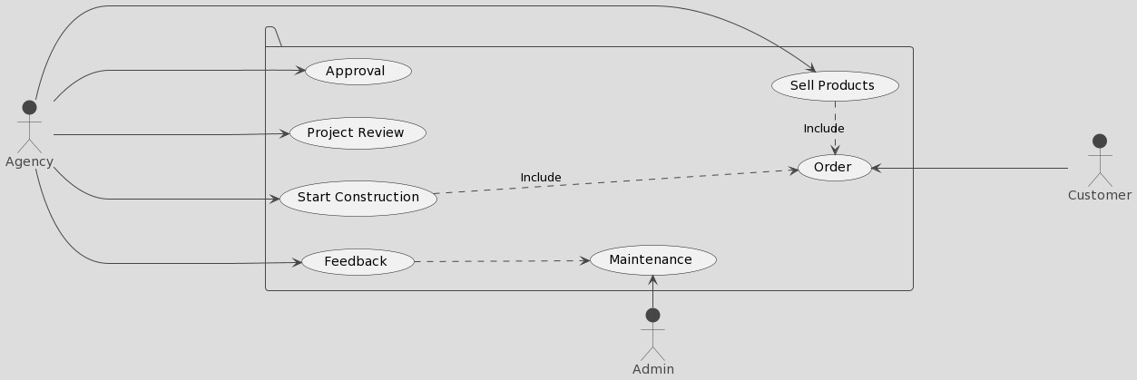
CONSTRUCTION AGENCY USE-CASE

Slide 9

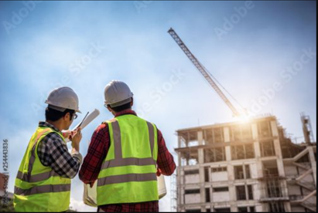
CUSTOMER VIRTUAL CUSTOMIZATION
SERVICE REQUEST AND PROJECT FINALIZATION
SMOOTH TRANSITION TO REAL-WORLD CONSTRUCTION
ACTIVE PARTICIPATION IN APPROVAL PROCESS
AUGMENTED REALITY (AR)
REAL SPACE OBSERVATION

Slide 10

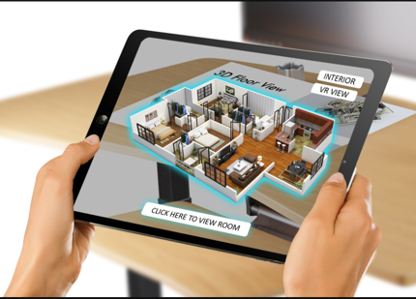
SERVICE REQUESTS
ORDER PLACEMENT
APPROVAL/DISAPPROVAL
USER-FRIENDLY EXPERIENCE
VIRTUAL TO TANGIBLE REALIZATION

Slide 11
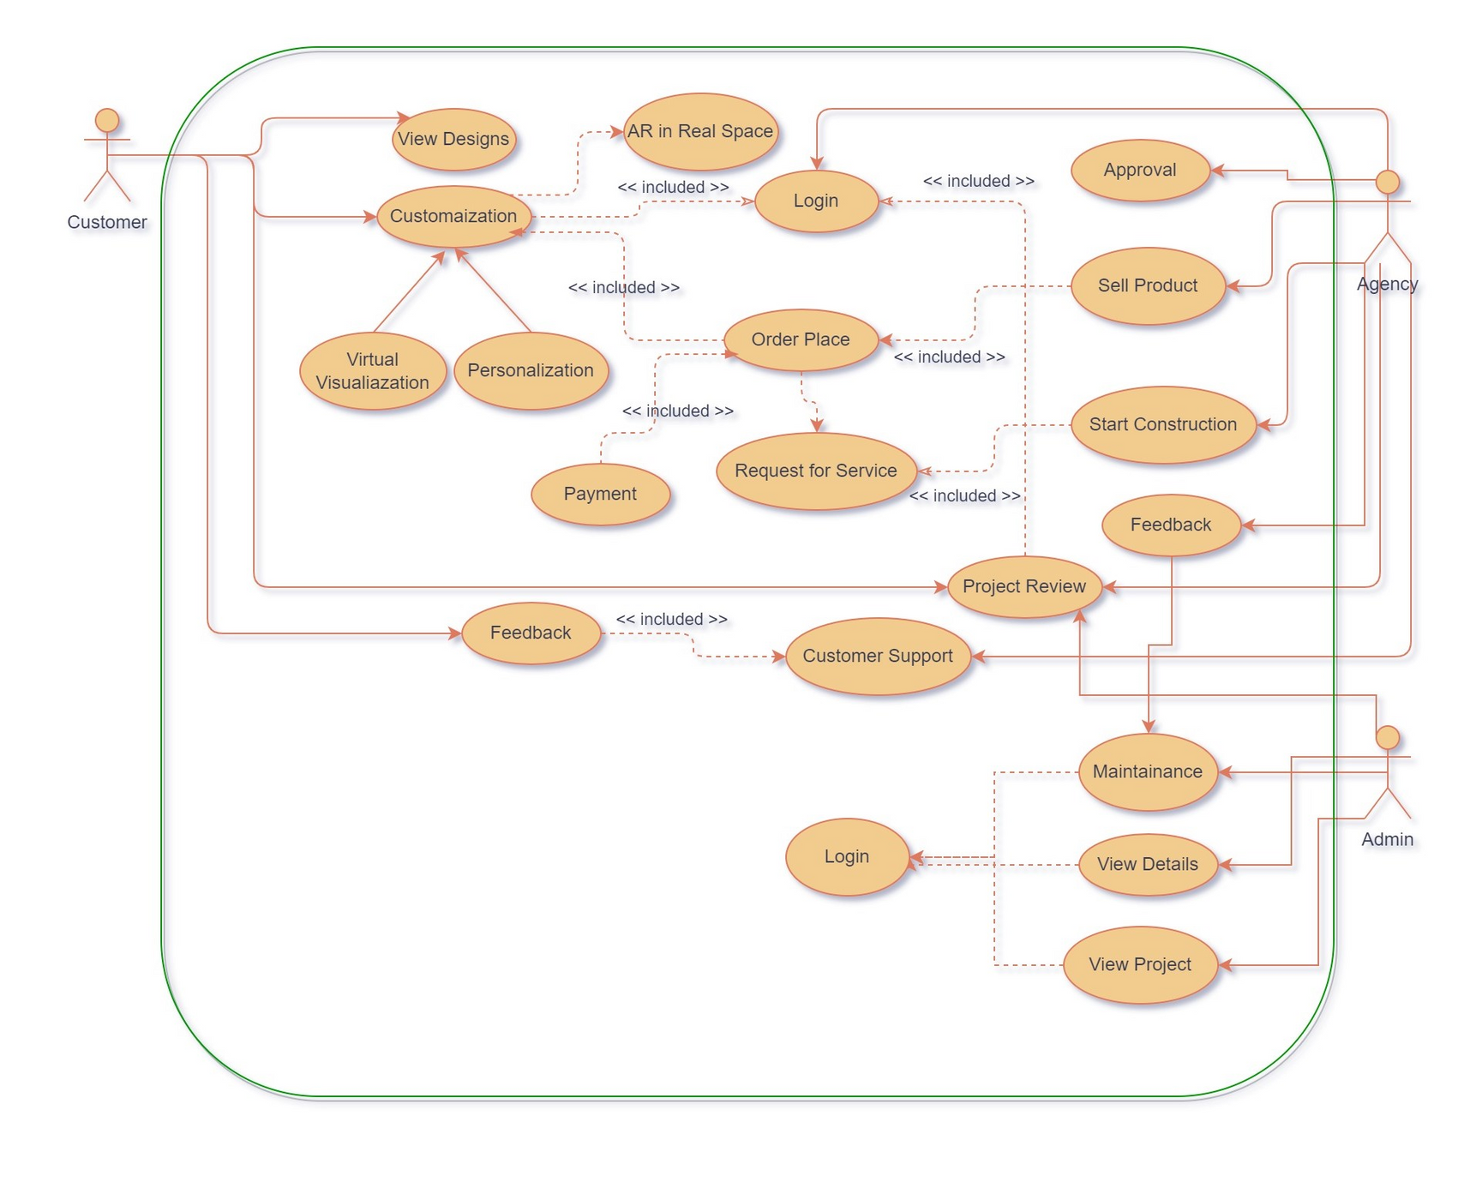
OVERALL USE-CASE

Slide 12
CONCLUSION
SEAMLESS INTERACTION LOOP
CUSTOMER VIRTUAL CUSTOMIZATION
ADMIN ROLE IN SYSTEM FUNCTIONALITY
SMOOTH TRANSITION TO REAL-WORLD CONSTRUCTION
ADMIN'S CENTRAL ROLE IN FEEDBACK MANAGEMENT
USER DETAILS MAINTENANCE BY ADMIN

Slide 13

THANKYOU !!
ANY QUESTIONS ?

